Slide 1
Servlets

Slide 2
Introduction

Slide 3
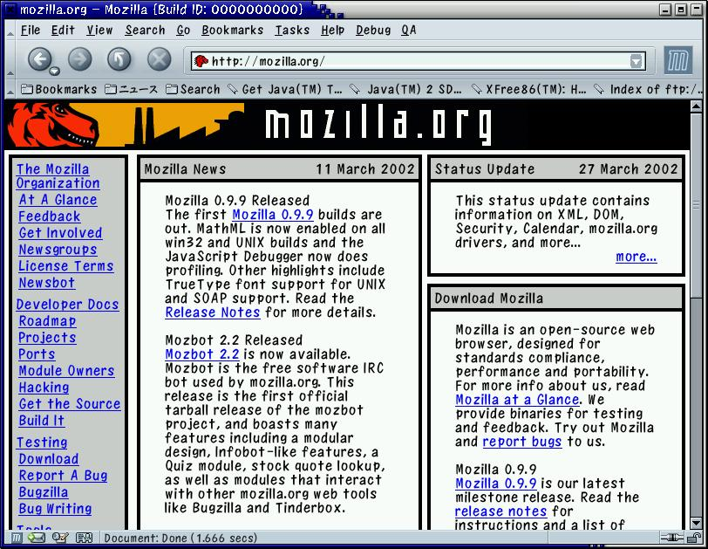
Static Pages
request
response
Web browser
Web server

Slide 4
Dynamic Pages
request
request
Servlet
JSP
ASP
response
response
Web browser
Web server

Slide 5
What is a Servlet?
Servlets are Java programs that can be run dynamically in a Web Server
Servlets are a server-side technology
A Servlet is an intermediating layer between an HTTP request of a client and the Web server

Slide 6
What do Servlets do?
Read data sent by the user (e.g., form data)
Look up other information about request in the HTTP request (e.g. authentication data, cookies, etc.)
Generate the results (may do this by talking to a database, file system, etc.)
Format the results in a document (e.g., make it into HTML)
Set the appropriate HTTP response parameters (e.g. cookies, content-type, etc.)
Send the document to the user

Slide 7

Supporting Servlets
The Web server must support Servlets (since it must run the Servlets):
  Apache Tomcat
  Sun’s Java System Web Server and Java System Application Server
  IBM's WebSphere Application Server
  Allaire Jrun – an engine that can be added to IIS, PWS, old Apache Web servers etc…
  Oracle Application Server
  …

Slide 8
Creating a Simple Servlet

Slide 9
The Servlet Interface
Java provides the interface Servlet
Specific Servlets implement this interface
Whenever the Web server is asked to invoke a specific Servlet, it activates the method service() of an instance of this Servlet
(HTTP)
response
MyServlet
service(request,response)
(HTTP)
request

Slide 10
HTTP Request Methods
POST - application data sent in the request body
GET - application data sent in the URL

Slide 11
Servlet Hierarchy
service(ServletRequest, ServletResponse)
Servlet
Generic Servlet
doGet(HttpServletRequest , HttpServletResponse)
doPost(HttpServletRequest HttpServletResponse)
doPut
doTrace
…
HttpServlet
YourOwnServlet

Slide 12
Class HttpServlet
Class HttpServlet handles requests and responses of HTTP protocol
The service() method of HttpServlet checks the request method and calls the appropriate HttpServlet method:
  doGet(), doPost()
  This class is abstract

Slide 13
Creating a Servlet
Extend the class HTTPServlet
Implement doGet or doPost (or both)
Both methods get:
  HttpServletRequest: methods for getting form (query) data, HTTP request headers, etc.
  HttpServletResponse: methods for setting HTTP status codes, HTTP response headers, and get an output stream used for sending data to the client
Usually implement doPost by calling doGet, or vice-versa

Slide 14
import java.io.*;
import javax.servlet.*; import javax.servlet.http.*;
public class TextHelloWorld extends HttpServlet {
public void doGet(HttpServletRequest req,
HttpServletResponse res)
throws ServletException, IOException {
PrintWriter out = res.getWriter();
out.println("Hello World");
out.close();
}
public void doPost(HttpServletRequest req,
HttpServletResponse res)
throws ServletException, IOException {
doGet(req, res);
}
}

Slide 15
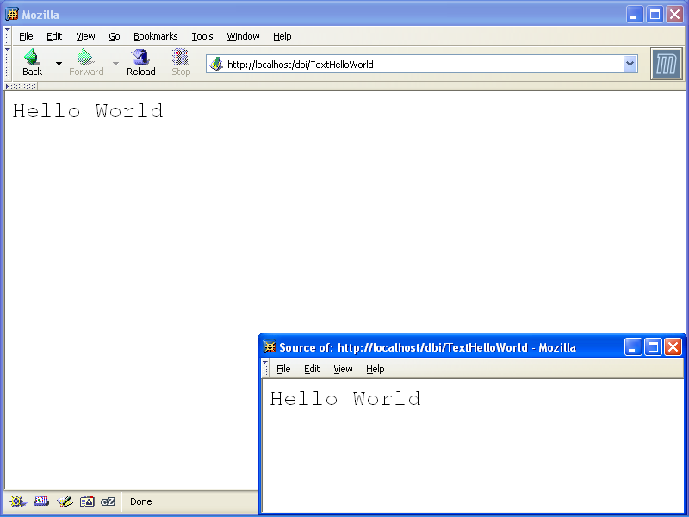

Slide 16
Returning HTML
By default a text response is generated
In order to generate HTML
  Tell the browser you are sending HTML, by setting the Content-Type header
  Modify the printed text to create a legal HTML page
You should set all headers before writing the document content. Can you guess why?

Slide 17
import java.io.*;
import javax.servlet.*; import javax.servlet.http.*;
public class HelloWorld extends HttpServlet {
public void doGet(HttpServletRequest req, HttpServletResponse res) throws ServletException, IOException {
res.setContentType("text/html");
PrintWriter out = res.getWriter();
out.println("<HTML><HEAD><TITLE>Hello
World</TITLE></HEAD>");
out.println(“<BODY><H1>Hello World
</H1></BODY></HTML>");
out.close();
}
}

Slide 18
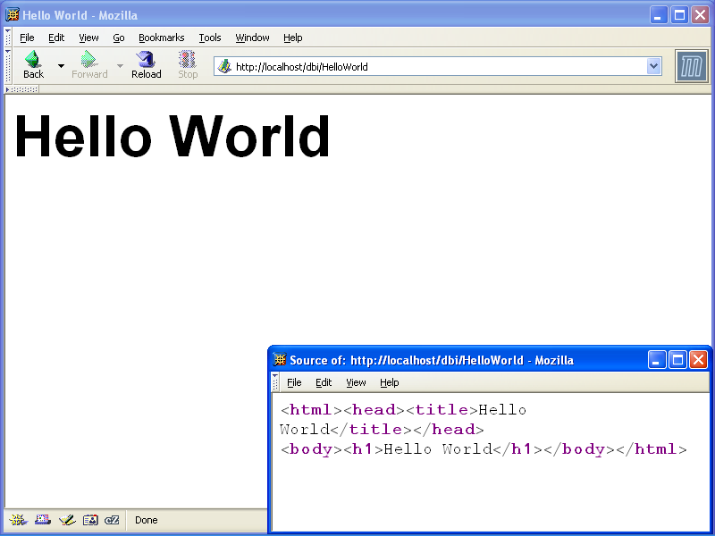

Slide 19
Configuring the Server
When your Servlet class is ready, you have to configure the Web server to recognize it
This includes:
  Telling the Server that the Servlet exists
  Placing the Servlet class file in a place known to the server
  Telling the server which URL should be mapped to the Servlet
These details are server specific and are not covered in this lecture

Slide 20
Getting Information
From the Request

Slide 21
Getting HTTP Data
Values of the HTTP request can be accessed through the HttpServletRequest object
Get the value of the header hdr using getHeader("hdr") of the request argument
Get all header names: getHeaderNames()
Methods for specific request information: getCookies, getContentLength, getContentType, getMethod, getProtocol, etc.

Slide 22
User Input in HTML
Using HTML forms, we can pass parameters to web applications
<form action=… method=…> …</form> comprises a single form
  action: the address of the application to which the form data is sent
  method: the HTTP method to use when passing parameters to the application (e.g. GET or POST)

Slide 23
The <input> Tag
Inside a form, INPUT tags define fields for data entry
Standard input types include: buttons, checkboxes, password field, radio buttons, text fields, image-buttons, text areas, hidden fields, etc.
They all associate a single (string) value with a named parameter

Slide 24

GET Example
<HTML>
<FORM method="GET" action="http://www.google.com/search">
<INPUT name="q" type="text">
<INPUT type="submit">
<INPUT type="reset">
</FORM>
</HTML>
http://www.google.com/search?q=servlets

Slide 25
Getting the Parameter Values
To get the value of a parameter named x:
  req.getParameter("x")
  where req is the service request argument
If there can be multiple values for the parameter:
  req.getParameterValues("x")
To get parameter names:
  req.getParameterNames()

Slide 26
<HTML>
<HEAD>
<TITLE>Sending Parameters</TITLE>
</HEAD>
<BODY BGCOLOR="#CC90E0">
<H1 ALIGN="LEFT">Please enter the parameters</H1>
<FORM ACTION=“SetColors”
METHOD=“GET”>
<TABLE>
<TR><TD>Background color:</TD>
<TD><INPUT TYPE="TEXT" NAME="bgcolor"></TD></TR>
<TR><TD>Font color:</TD>
<TD><INPUT TYPE="TEXT" NAME="fgcolor"></TD></TR>
<TR><TD>Font size:</TD>
<TD><INPUT TYPE="TEXT" NAME="size"></TD></TR>
</TABLE> <BR>
<INPUT TYPE="SUBMIT" VALUE="Show Page">
</FORM>
</BODY>
</HTML>

Slide 27
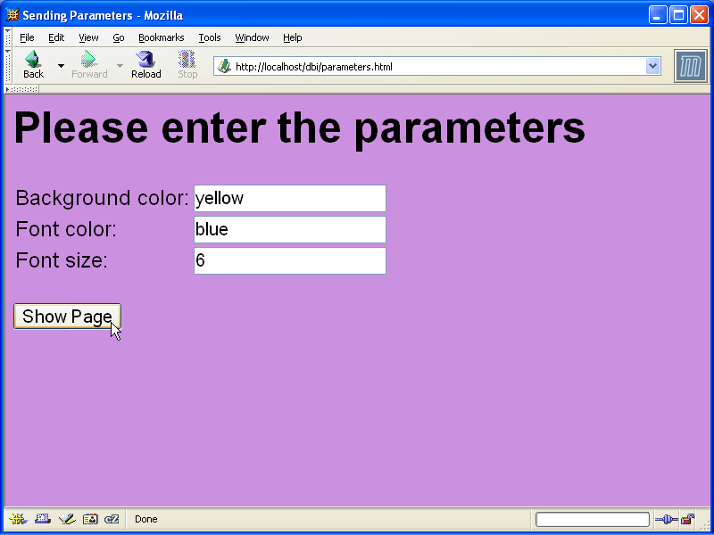

Slide 28
import java.io.*;
import javax.servlet.*;
import javax.servlet.http.*;
public class SetColors extends HttpServlet {
public void doGet(HttpServletRequest request,
HttpServletResponse response)
throws ServletException, IOException {
response.setContentType("text/html");
PrintWriter out = response.getWriter();
String bg = request.getParameter("bgcolor");
String fg = request.getParameter("fgcolor");
String size = request.getParameter("size");

Slide 29
out.println("<HTML><HEAD><TITLE>Set Colors Example" +
"</TITLE></HEAD>");
out.println("<BODY text='" + fg +
"' bgcolor='" + bg + "'>");
out.println("<H1>Set Colors Example</H1>");
out.println("<FONT size='" + size + "'>");
out.println("You requested a background color " +
bg + "<P>");
out.println("You requested a font color " +
fg + "<P>");
out.println("You requested a font size " +
size + "<P>");
out.println("</FONT></BODY></HTML>");
}
}

Slide 30
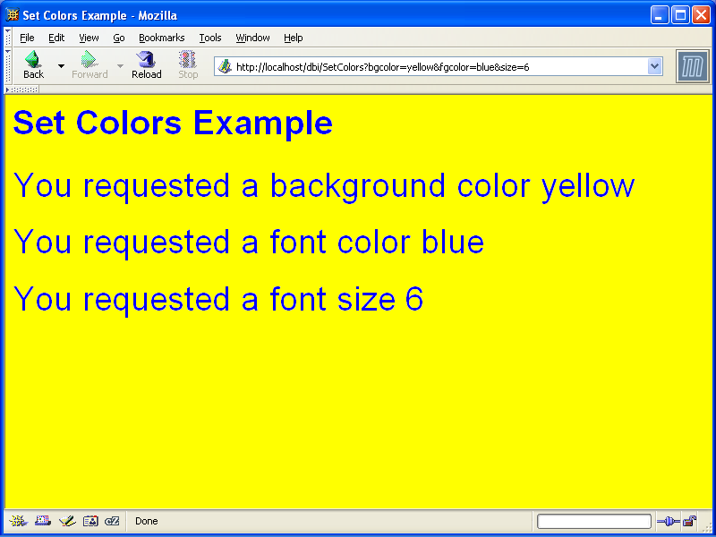

Slide 31
Handling Post
You don't have to do anything different to read POST data instead of GET data!!
<FORM ACTION=“SetColors”
METHOD=“POST”> …
public void doPost(HttpServletRequest request,
HttpServletResponse response)
throws ServletException, IOException {
doGet(request, response);
}

Slide 32
Supporting HTTP Methods

Slide 33
The HEAD Method
The default implementation of doHead is executing doGet and excluding the response body
In addition, the size of the body is calculated and added to the headers
You do not have to override this method
  Why would one like to override this method?

Slide 34
OPTIONS and TRACE
doOptions returns the supported methods:
  For example, if you override doGet then the following header will be returned:
    Allow: GET, HEAD, TRACE, OPTIONS
doTrace returns the request itself in the body of the message, for debugging purposes
You usually do not override these methods
  Override doOptions if you offer some new methods…

Slide 35
Unsupported Methods
By default, the methods doPost, doGet, doPut and doDelete return an error status code 405 with the message:
  HTTP method XXX is not supported by this URL
In particular, you have to override doGET and doPost if you want to return an appropriate response for these methods
  Many applications support only one of GET/POST

Slide 36
Servlet Life Cycle

Slide 37
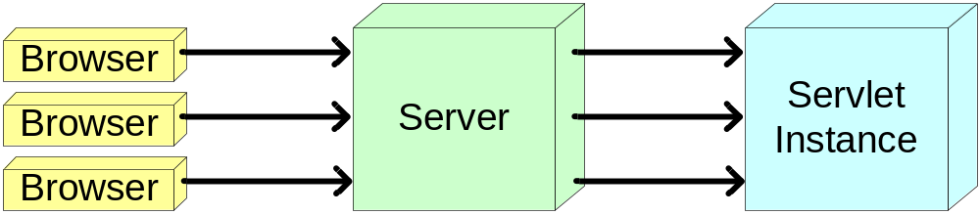
Servlet Life Cycle
The server loads the Servlet class and initializes one instance of it
Each client request is handled by the Serlvet instance in a separate thread
The server can remove the servlet
The servlet can remain loaded to handle additional requests

Slide 38
Servlet Life Cycle
When the Servlet in instantiated, its method init is begin invoked
  External parameters are supplied
Upon a request, the method service of the Servlet is being invoked
Before the Servlet removal, its method destroy is being invoked

Slide 39
Servlet Life Cycle
Deal with requests:
call the
service method
Calling the
init method
Destroy the Servlet:
call the
destroy method
Servlet
Instance
ServletConfig
Garbage
Collection
Servlet Class

Slide 40
Initializing Servlets
Performed when the Servlet is loaded into the Web server
Servlet’s init(ServletConfig) method is called
ServletConfig has methods to get initialization parameters
  Put these parameters in a file that is known to the server
To make initializations, override init()
  init() is automatically called by init(ServletConfig) after performing default initializations

Slide 41
A Glance at Servlet Configuration Parameters
<web-app>
…
<servlet>
<servlet-name>InitExample</servlet-name>
<servlet-class>ServletInit</servlet-class>
<init-param>
<param-name>login</param-name>
<param-value>snoopy</param-value>
</init-param>
</servlet>
…
</web-app>

